Slide 1
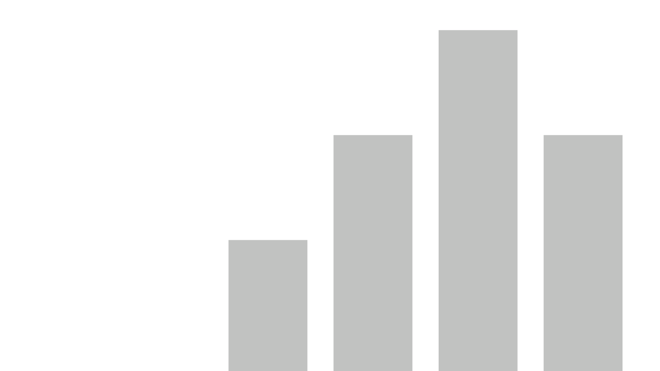


CONTINENT GDP
View in Power BI
Last data refresh:
10/22/2020 1:03:42 PM UTC
Downloaded at:
3/31/2022 8:39:36 PM UTC

Slide 2
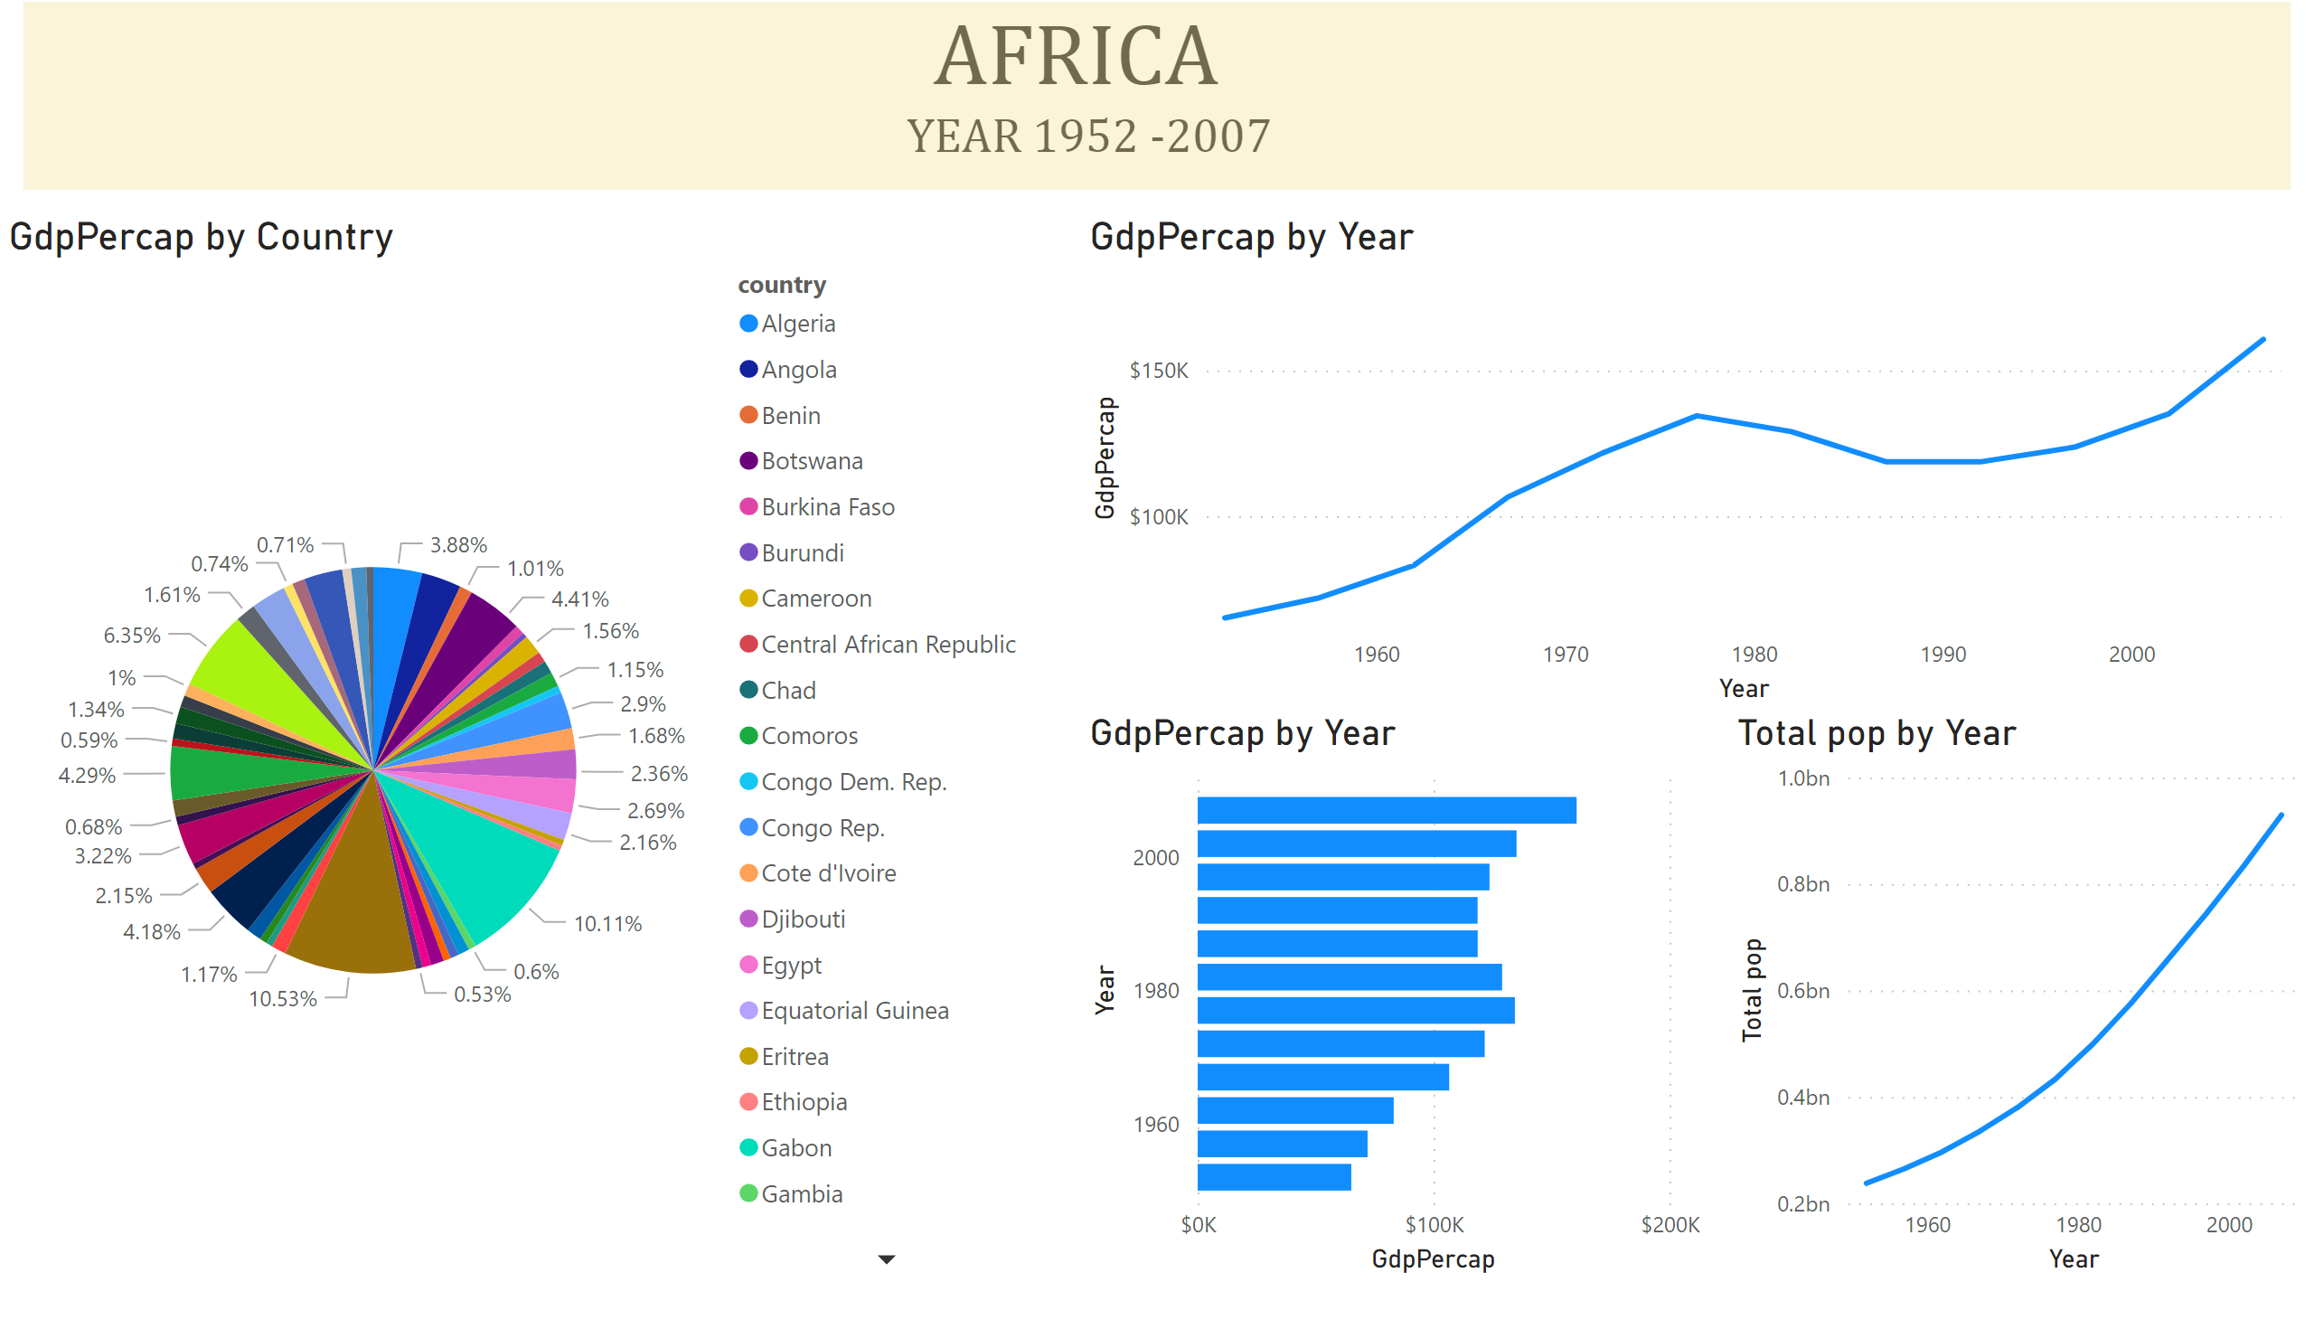
AFRICA
Notes:
textbox
No alt text provided
clusteredBarChart
No alt text provided
GdpPercap by Country
No alt text provided
lineChart
No alt text provided
lineChart
No alt text provided
basicShape
No alt text provided

Slide 3
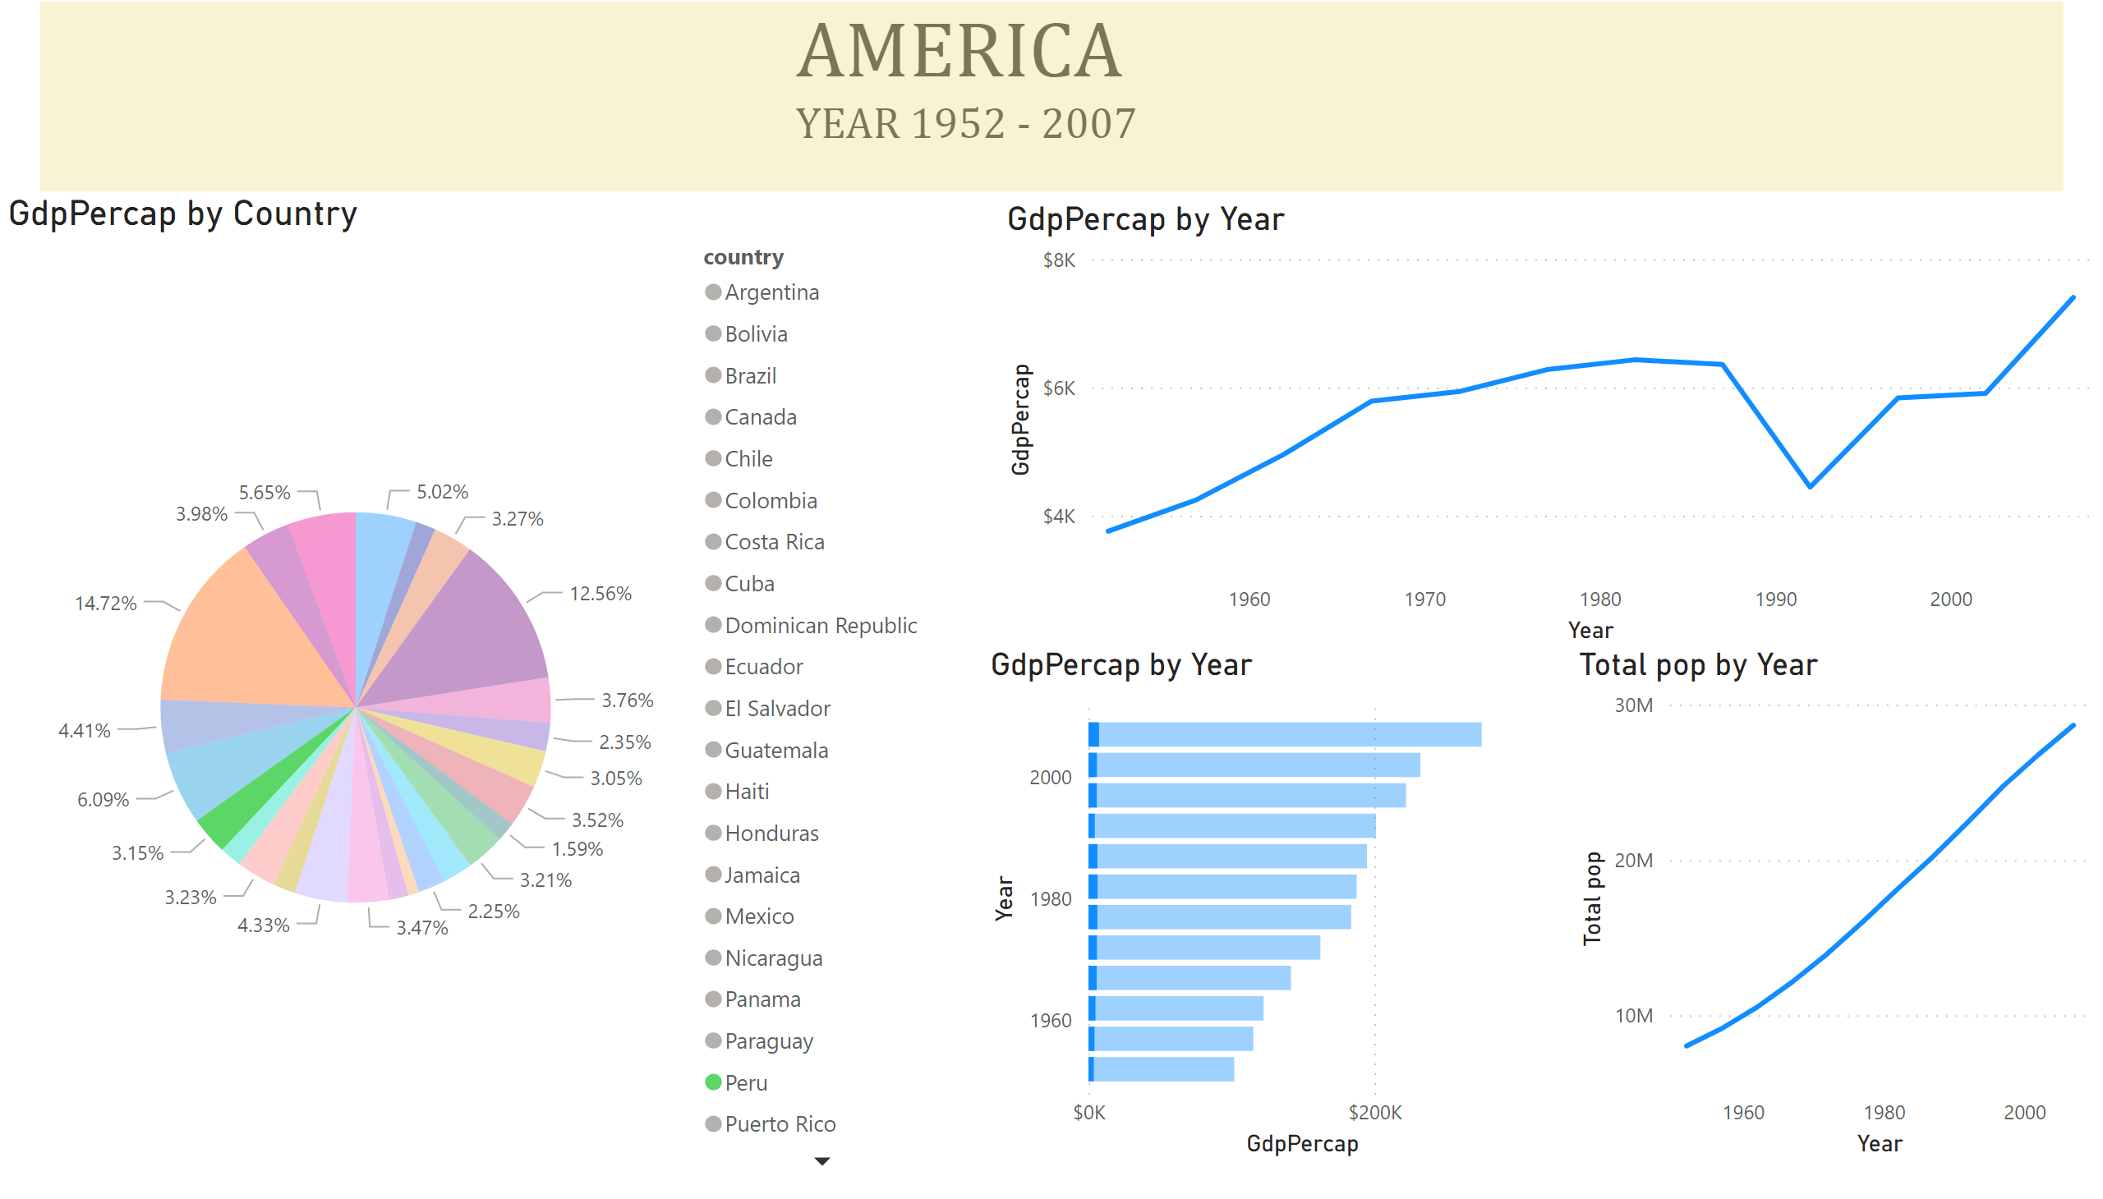
AMERICA
Notes:
GdpPercap by Country
No alt text provided
textbox
No alt text provided
lineChart
No alt text provided
clusteredBarChart
No alt text provided
lineChart
No alt text provided
basicShape
No alt text provided

Slide 4
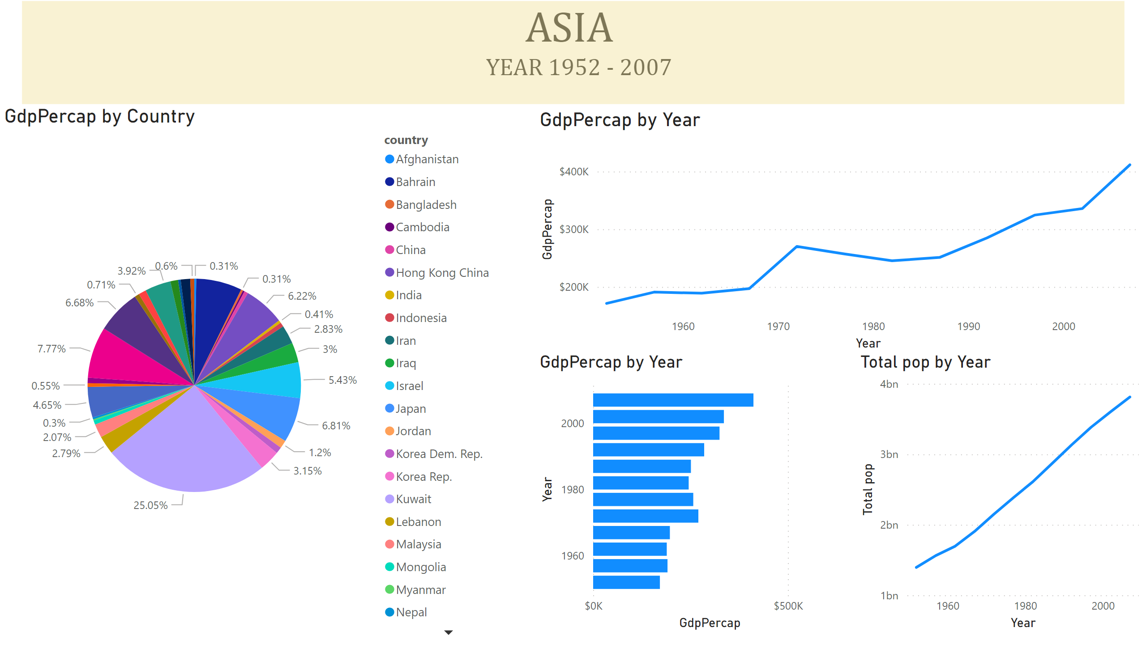
ASIA
Notes:
GdpPercap by Country
No alt text provided
textbox
No alt text provided
lineChart
No alt text provided
clusteredBarChart
No alt text provided
lineChart
No alt text provided
basicShape
No alt text provided

Slide 5
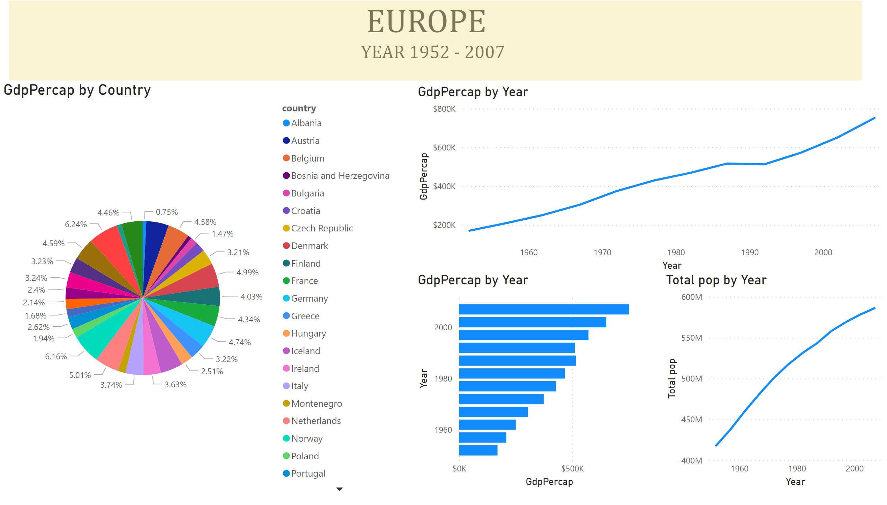
EUROPE
Notes:
GdpPercap by Country
No alt text provided
textbox
No alt text provided
lineChart
No alt text provided
clusteredBarChart
No alt text provided
lineChart
No alt text provided
basicShape
No alt text provided

